Slide 1
Design And implementation of a Register Allocator
S. mahesh(192211754)
k. Manoj Kumar
B. Vishnu Vardhan

Slide 2
Introduction:
Compiler design is foundational to software development, as it bridges the gap between human-readable code and machine-executable instructions.
It encompasses a series of complex processes, including lexical analysis, parsing, optimization, and code generation, with the ultimate goal of producing efficient and reliable executable programs.
This project seeks to address the challenge of register allocation optimization within compiler design, aiming to enhance the efficiency and effectiveness of compiled code in high-performance computing environments.

Slide 3
it encompasses a series of complex processes, including lexical analysis, parsing, optimization, and code generation, with the ultimate goal of producing efficient and reliable executable programs. efficient register allocation, in particular, plays a critical role in optimizing program performance by minimizing memory accesses and maximizing the utilization of hardware resources. traditional optimization techniques, such as constant folding, loop unrolling, and dead code elimination, have been instrumental in enhancing program speed and reducing resource usage. identify key research gaps, and lay the groundwork for innovative solutions in register allocation optimization.

Slide 4
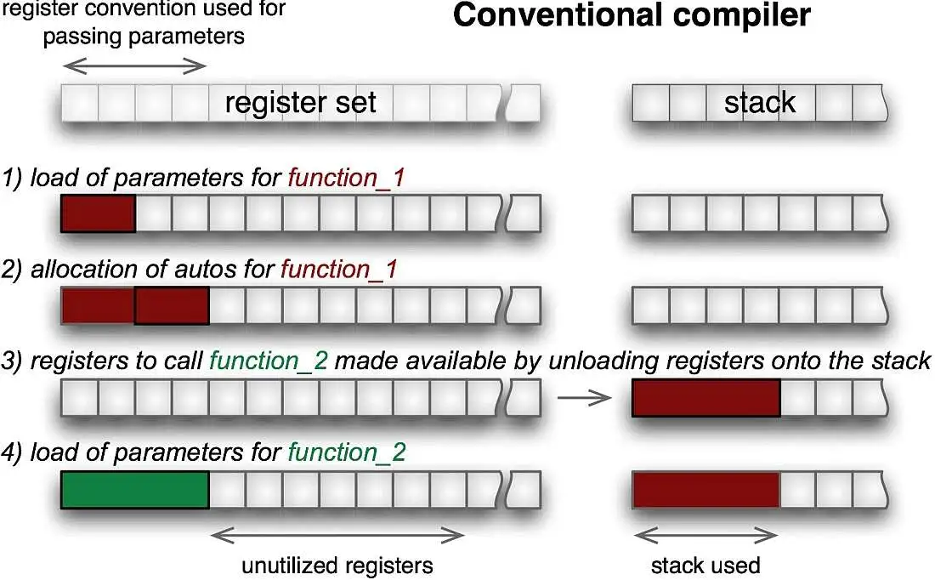

Slide 5
Statement of the problem: Need for efficient optimization techniques.

Slide 6
Literature Review: A literature review of optimization techniques in compiler design encompasses a wide range of research papers, books, and articles covering . By reviewing the literature in these areas, researchers and practitioners can gain a comprehensive understanding of optimization techniques in compiler design.

Slide 7
Objectives: Clearly define the goals and objectives of the project. Scope and limitations of the study regarding optimization techniques. Improvement in generated code, with a view towards advancing the state-of-the-art is in compiler design and optimization.

Slide 8
Methodology: Firstly i collected the information from articles , internet resource. and some ai tools like chat gpt etc.. Then i collected code for my project from through internet and used google collab to get my output for my topic

Slide 9
Code optimization techniques: Overview of different register allocation algorithms (e.g., graph coloring, linear scan). Design choices for the front-end encompass considerations such as tokenization, syntax parsing, and semantic validation. The front-end of the compiler serves as the entry point for source code, responsible for lexical analysis, parsing, and semantic analysis.

Slide 10
Intermediate Representation: Discussion on the intermediate representation utilized for register allocation. Explanation of how the representation impacts register allocation decisions. The chosen intermediate representation (ir) serves as a pivotal component in the optimization phase of the compiler.

Slide 11
Implementation Details: In addition to register allocation, the project explores a variety of advanced optimization techniques aimed at further improving program performance. By leveraging these advanced techniques in conjunction with register allocation optimization, the project aims to unlock additional performance gains and enhance the overall efficiency of compiled code. These techniques encompass a wide range of optimizations, including loop optimization, parallelization, vectorization, and memory hierarchy optimization.

Slide 12
Experimental Setup: The experimental setup encompasses the environment and methodology used to evaluate the effectiveness and efficiency of the implemented register allocation algorithm. The test environment includes hardware specifications, such as processor architecture and memory configuration, as well as software dependencies, such as compiler versions and optimization settings. Performance metrics, including execution time, memory usage, and cpu utilization, are measured to provide quantitative insights into the algorithm's efficacy.

Slide 13
Results and Analysis: Experimental results are presented in the form of performance metrics, comparative analysis against existing optimization techniques, and discussion of any observed trade-offs or limitations. Through rigorous analysis and interpretation of experimental data, the project aims to elucidate the strengths and weaknesses of the implemented algorithm and inform future research directions in register allocation optimization. The results and analysis section presents the findings of experimental evaluations, providing insights into the performance and effectiveness of the implemented register allocation

Slide 14
Integration of Machine Learning: Exploring the integration of machine learning techniques for adaptive optimization represents a cutting-edge direction in compiler design and optimization. This section explores the potential benefits of integrating machine learning into the compiler optimization pipeline, including improved performance, enhanced adaptability, and reduced development overhead. This section explores the potential benefits of integrating machine learning into the compiler optimization pipeline, including improved performance, enhanced adaptability, and reduced development overhead

Slide 15
Challenges and Future Work: Suggestions for future work encompass areas such as optimization refinement, algorithmic innovation, toolchain integration, and exploration of emerging technologies. By identifying and addressing these challenges, the project aims to pave the way for continued innovation and advancement in compiler design and optimization.

Slide 16
Conclusion: Summary of key findings regarding register allocation optimization. concluding remarks on the importance and implications of the research. The findings of this research underscore the importance of compiler optimization in enabling high-performance computing solutions Highlight the potential impact of continued innovation in compiler design and optimization.

Slide 17
References: Comprehensive list of all references and sources cited in the project. The references section provides a comprehensive list of all sources cited throughout the project, including academic papers, textbooks, software documentation, and research articles. Appendices: Additional information, code snippets, or supplementary material related to register allocation implementation and experimentation . feel free to adjust or expand upon each section based on the specific requirements and focus of your project.

Slide 18
thank you…

